Slide 1

Dr. A.P.J. Abdul Kalam Technical University
ERROR DETECTION AND
ERROR CORRECTION
DATA LINK CONTROL
BY:- PARUL GAHELOT
&
VISHAL CHOUDHARY

Slide 2
Error Detection and Correction
Types of Errors
Detection
Correction

Slide 3
Basic concepts
Networks must be able to transfer data from one device to another with complete accuracy.
Data can be corrupted during transmission.
For reliable communication, errors must be detected and corrected.
Error detection and correction are implemented either at the data link layer or the transport layer of the OSI model.

Slide 4
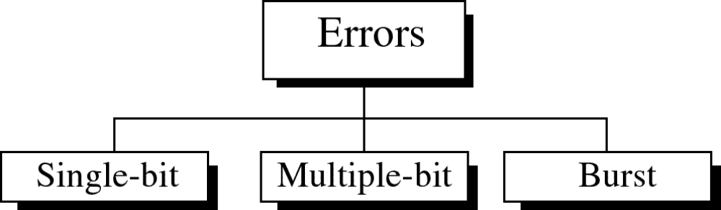
Types of Errors

Slide 5
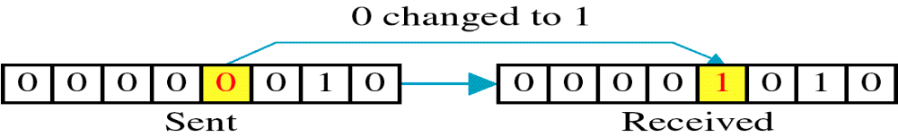
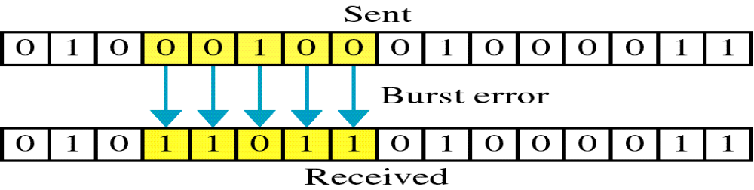
Single-bit error
Burst error

Slide 6
Single bit errors are the least likely type of errors in serial data transmission because the noise must have a very short duration which is very rare. However this kind of errors can happen in parallel transmission.
Example:
If data is sent at 1Mbps then each bit lasts only 1/1,000,000 sec. or 1 μs.
For a single-bit error to occur, the noise must have a duration of only 1 μs, which is very rare.

Slide 7
The term burst error means that two or more bits in the data unit have changed from 1 to 0 or from 0 to 1.
Burst errors does not necessarily mean that the errors occur in consecutive bits, the length of the burst is measured from the first corrupted bit to the last corrupted bit. Some bits in between may not have been corrupted.

Slide 8
Burst error is most likely to happen in serial transmission since the duration of noise is normally longer than the duration of a bit.
The number of bits affected depends on the data rate and duration of noise.
Example:
If data is sent at rate = 1Kbps then a noise of 1/100 sec can affect 10 bits.(1/100*1000)
If same data is sent at rate = 1Mbps then a noise of 1/100 sec can affect 10,000 bits.(1/100*10⁶)

Slide 9
Error detection
Error detection means to decide whether the received data is correct or not without having a copy of the original message.
Error detection uses the concept of redundancy, which means adding extra bits for detecting errors at the destination.
Notes:
Make sense of message.
Make sense of message.

Slide 10
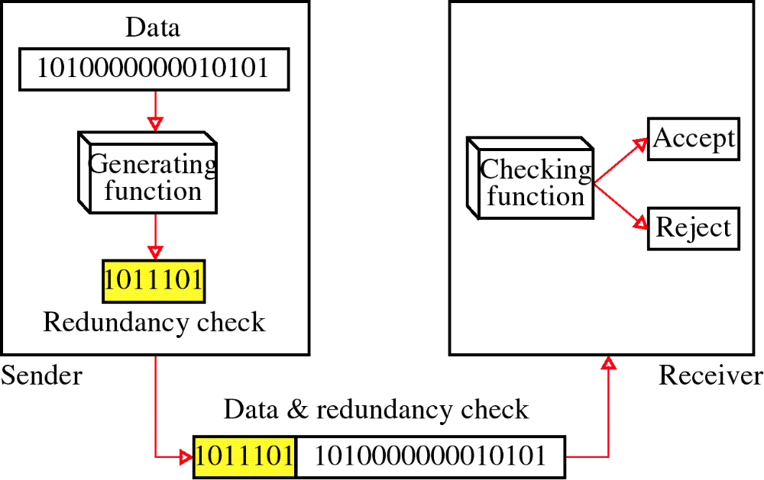
Redundancy

Slide 11
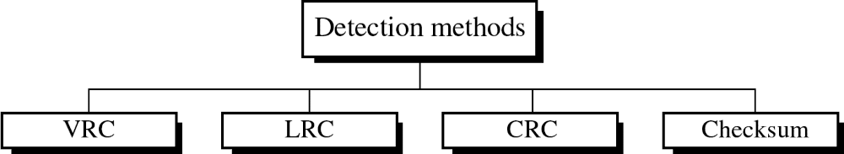
Four types of redundancy checks are used
in data communications

Slide 12
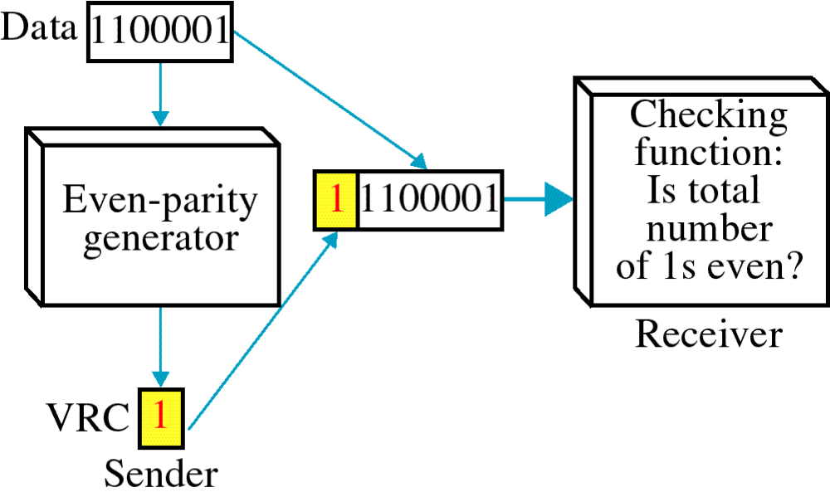
Vertical Redundancy Check
VRC

Slide 13
Performance
It can detect single bit error
It can detect burst errors only if the total number of errors is odd.

Slide 14
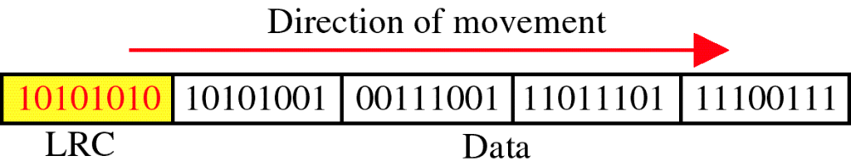
Longitudinal Redundancy Check
LRC

Slide 15
Performance
LCR increases the likelihood of detecting burst errors.
If two bits in one data units are damaged and two bits in exactly the same positions in another data unit are also damaged, the LRC checker will not detect an error.

Slide 16
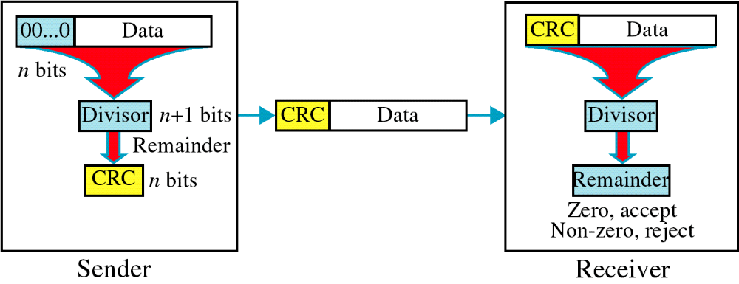
Cyclic Redundancy Check
CRC

Slide 17
Cyclic Redundancy Check
Given a k-bit frame or message, the transmitter generates an n-bit sequence, known as a frame check sequence (FCS), so that the resulting frame, consisting of (k+n) bits, is exactly divisible by some predetermined number.
The receiver then divides the incoming frame by the same number and, if there is no remainder, assumes that there was no error.

Slide 18
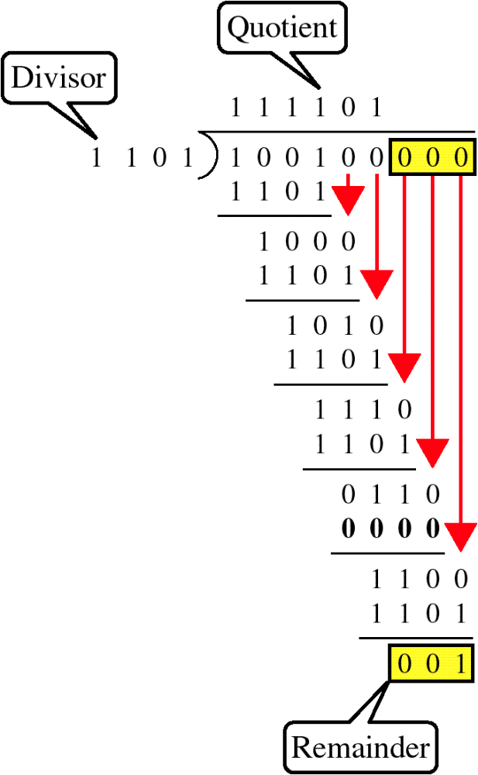
Binary Division

Slide 19
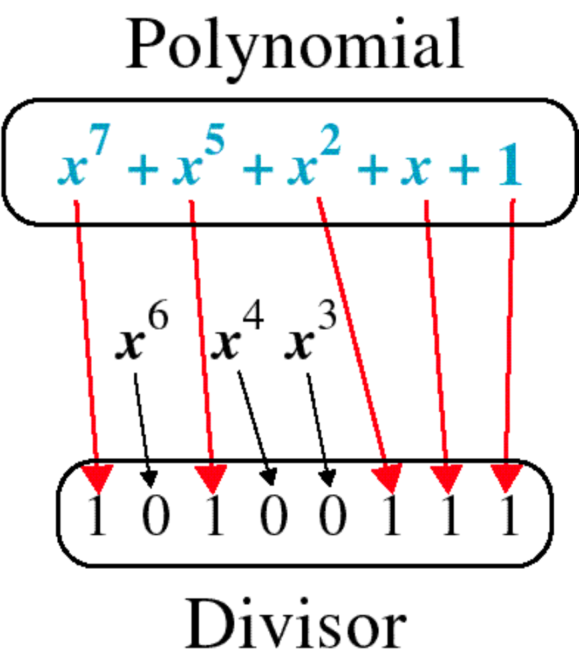
Polynomial and Divisor

Slide 20
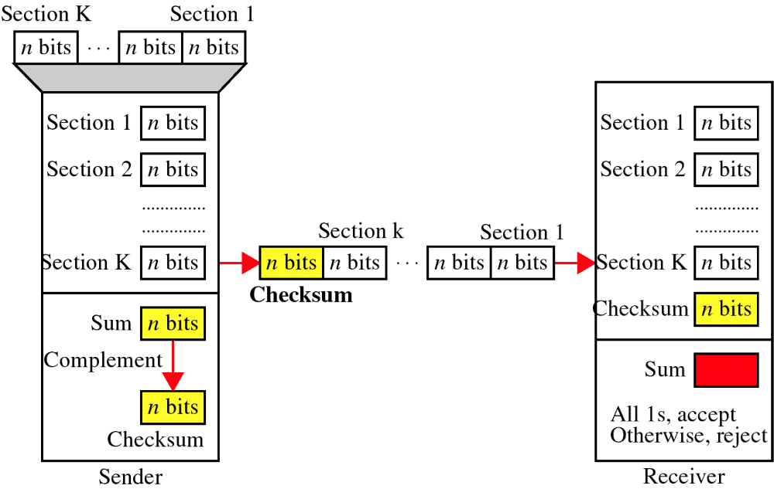
Checksum

Slide 21
Performance
The checksum detects all errors involving an odd number of bits.
It detects most errors involving an even number of bits.
If one or more bits of a segment are damaged and the corresponding bit or bits of opposite value in a second segment are also damaged, the sums of those columns will not change and the receiver will not detect a problem.

Slide 22
Error Correction
It can be handled in two ways:
receiver can have the sender retransmit the entire data unit.
The receiver can use an error-correcting code, which automatically corrects certain errors.

Slide 23
Single-bit error correction
To correct an error, the receiver reverses the value of the altered bit. To do so, it must know which bit is in error.
Number of redundancy bits needed
Let data bits = m
Redundancy bits = r
∴Total message sent = m+r
The value of r must satisfy the following relation:
2^{r} ≥ m+r+1

Slide 24
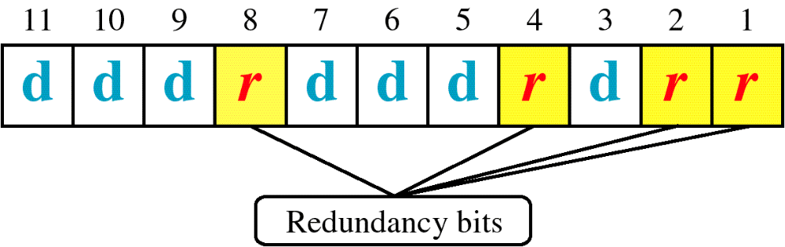
Hamming Code

Slide 25
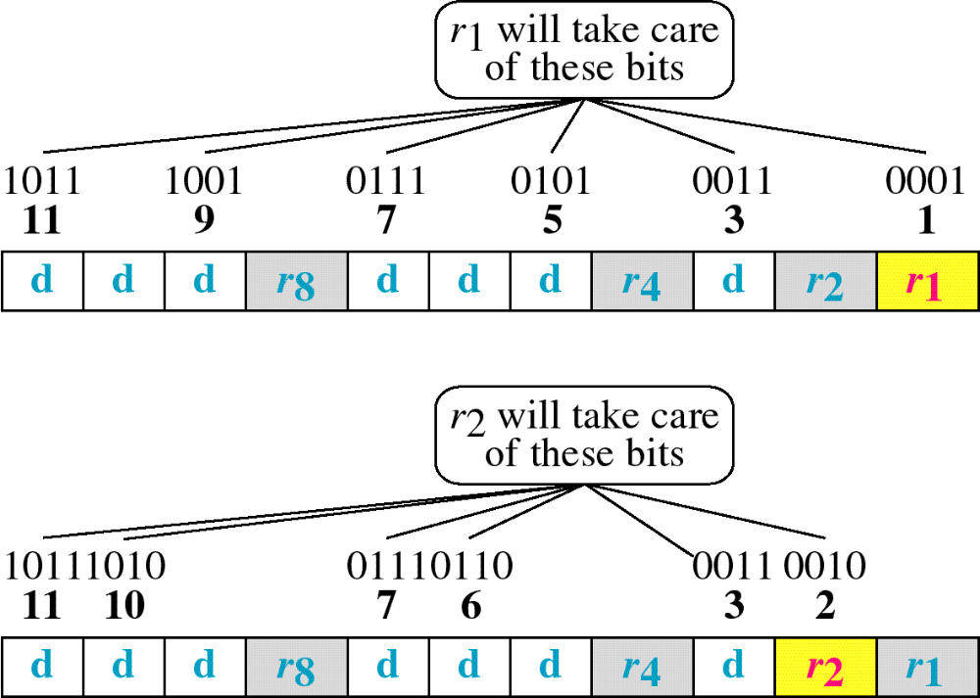
Hamming Code

Slide 26
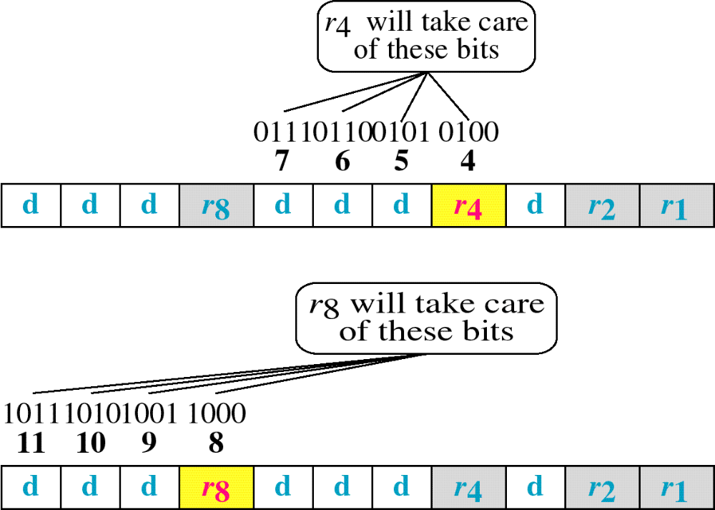
Hamming Code

Slide 27
Data Link Control

Slide 28
FLOW AND ERROR CONTROL
The most important responsibilities of the data link layer are flow control and error control. Collectively, these functions are known as data link control.

Slide 29
Flow control refers to a set of procedures used to restrict the amount of data
that the sender can send before
waiting for acknowledgment.
Error control in the data link layer is based on automatic repeat request, which is the retransmission of data.

Slide 30
PROTOCOLS
How the data link layer can combine flow control and error control to achieve the delivery of data from one node to another. The protocols are normally implemented in software by using one of the common programming languages. To make our discussions language-free, we have written in pseudocode a version of each protocol that concentrates mostly on the procedure instead of delving into the details of language rules.

Slide 31


Slide 32
NOISELESS CHANNELS
Let us first assume we have an ideal channel in which no frames are lost, duplicated, or corrupted. We introduce two protocols for this type of channel.
NOISELESS
STOP-AND-WAIT

Slide 33

The design of the simplest protocol with no flow or error control
Example of communication using this protocol. It is very simple. The sender sends a sequence of frames without even thinking about the receiver. To send three frames, three events occur at the sender site and three events at the receiver site. Note that the data frames are shown by tilted boxes; the height of the box defines the transmission time difference between
the first bit and the last bit in the frame.

Slide 34

Flow diagram

Slide 35

Design of Stop-and-Wait Protocol
Example of communication using this protocol. It is still very simple. The sender sends one frame and waits for feedback from the receiver. When the ACK arrives, the sender sends the next frame.

Slide 36

Flow diagram

Slide 37
NOISY CHANNELS
We discuss three protocols in this section that use error control.
Stop-and-Wait Automatic Repeat Request
Go-Back-N Automatic Repeat Request
Selective Repeat Automatic Repeat Request

Slide 38
Stop-and-Wait ARQ
Error correction in Stop-and-Wait ARQ is done by keeping a copy of the sent frame and retransmitting of the frame when the timer expires.

Slide 39

Design of the Stop-and-Wait ARQ Protocol
Example of Stop-and-Wait ARQ. Frame 0 is sent and acknowledged. Frame 1 is lost and resent after the time-out. The resent frame 1 is acknowledged and the timer stops. Frame 0 is sent and acknowledged, but the acknowledgment is lost. The sender has no idea if the frame or the acknowledgment is lost, so after the time-out, it resends frame 0, which is acknowledged.

Slide 40

Flow diagram

Slide 41

GO-BACK-N
Send window for Go-Back-N ARQ

Slide 42

Receive window for Go-Back-N ARQ

Slide 43

diagram

Slide 44
This is an example of a case where the forward channel is reliable, but the reverse is not. No data frames are lost, but some ACKs are delayed and one is lost. The example also shows how cumulative acknowledgments can help if acknowledgments are delayed or lost. After initialization, there are seven sender events. Request events are triggered by data from the network layer; arrival events are triggered by acknowledgments from the physical layer. There is no time-out event here because all outstanding frames are acknowledged before the timer expires. Note that although ACK 2 is lost, ACK 3 serves as both ACK 2 and ACK 3.

Slide 45

diagram

Slide 46
This shows what happens when a frame is lost. Frames 0, 1, 2, and 3 are sent. However, frame 1 is lost. The receiver receives frames 2 and 3, but they are discarded because they are received out of order. The sender receives no acknowledgment about frames 1, 2, or 3. Its timer finally expires. The sender sends all outstanding frames (1, 2, and 3) because it does not know what is wrong. Note that the resending of frames 1, 2, and 3 is the response to one single event. When the sender is responding to this event, it cannot accept the triggering of other events. This means that when ACK 2 arrives, the sender is still busy with sending frame 3.
The physical layer must wait until this event is completed and the data link layer goes back to its sleeping state. We have shown a vertical line to indicate the delay. It is the same story with ACK 3; but when ACK 3 arrives, the sender is busy responding to ACK 2. It happens again when ACK 4 arrives. Note that before the second timer expires, all outstanding frames have been sent and the timer is stopped.

Slide 47
Stop-and-Wait ARQ is a special case of Go-Back-N ARQ in which the size of the send window is 1.

Slide 48

Send window for Selective Repeat ARQ

Slide 49

Receive window for Selective Repeat ARQ

Slide 50
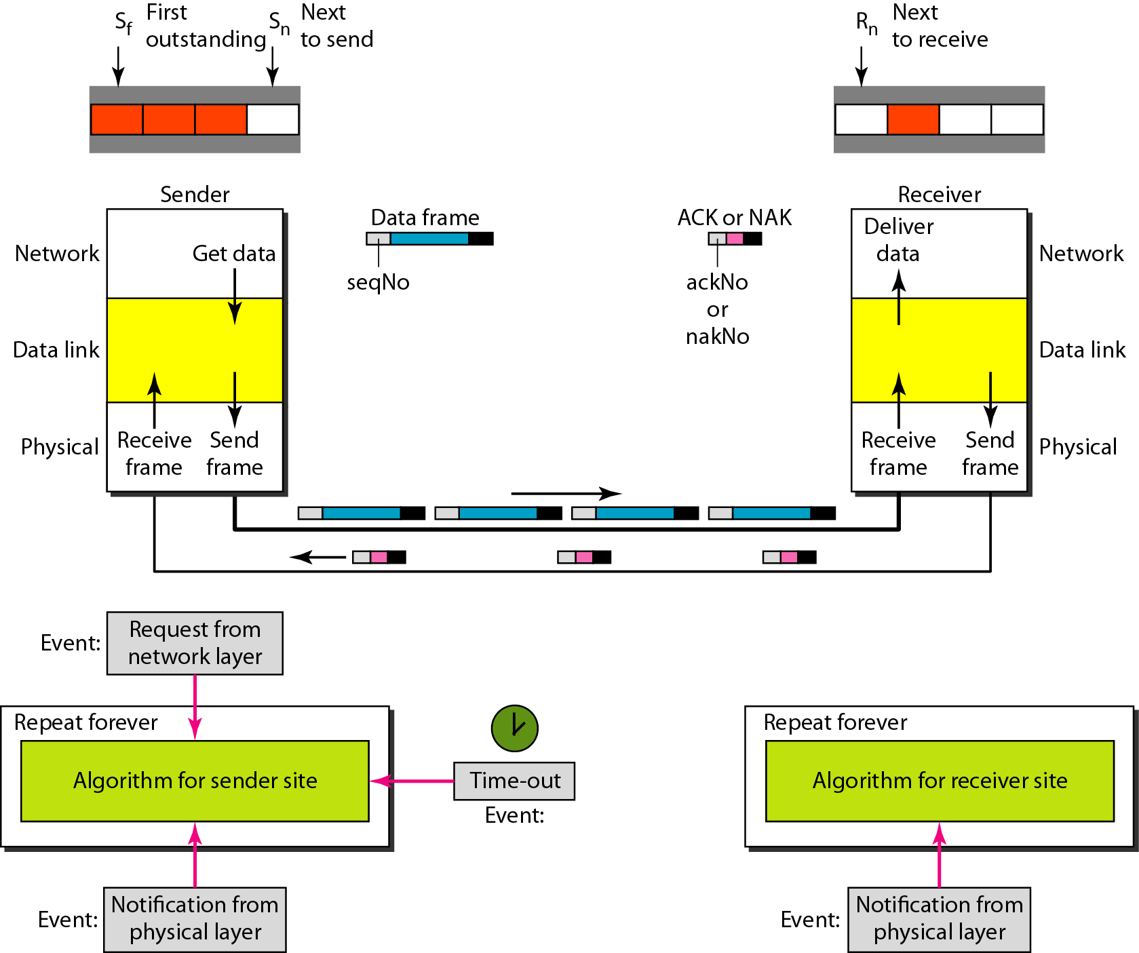
Design of Selective Repeat ARQ

Slide 51
THANK YOU

